Slide 1
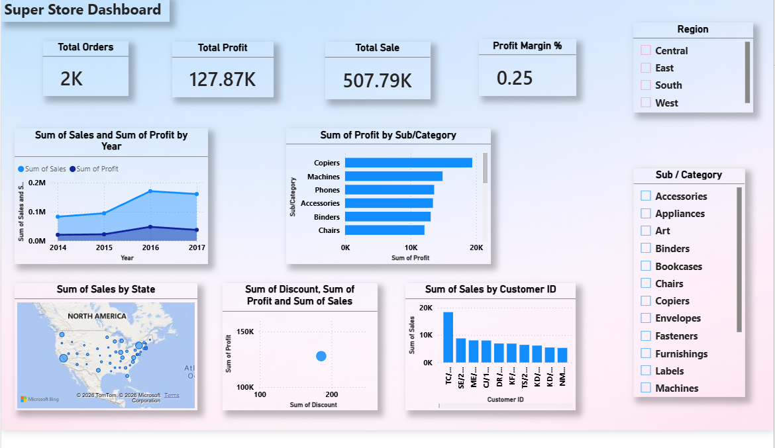
Super Store Dashboard Storyboard
Content:
Comprehensive analysis of sales, profit, and customer trends.
Category and regional breakdown for deeper insights.
Strategic recommendations for growth and profitability.
Insight: “A data‑driven view of business performance, designed to guide smarter decisions.”

Slide 2




Business Performance Overview
Content:
Total Orders: 2K → steady order flow.
Total Sales: 507.79K → strong revenue growth.
Total Profit: 127.87K → solid operational performance.
Profit Margin: 0.25% → efficiency challenges due to discounts/costs.
Insight: “Sales and profit are growing, but margins remain tight. Focus on cost control and discount optimization.”

Slide 3
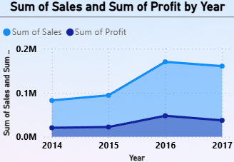
Sales & Profit Trends
Content:
Sales and Profit show consistent upward growth.
Clear seasonal peaks in Q4 each year.
Q4 2017 recorded highest revenue.
Profit growth slower than sales → margin compression.
Insight: “ Seasonal demand drives Q4 spikes — plan inventory and staffing to maximize profitability.”

Slide 4
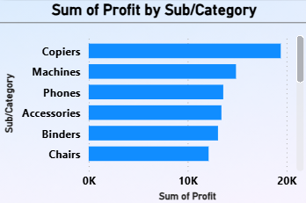
Category Performance
Content:
Copiers and Machines lead profitability.
Phones and Accessories show moderate profit.
Furniture and Bookcases lag behind.
Technology categories drive margins.
Insight: “Re‑evaluate pricing for low‑margin categories; expand Technology offerings to sustain growth.”

Slide 5
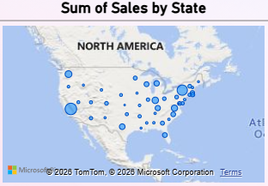
Regional Sales & Profit
Content:
West region dominates in sales and profit.
East region steady performer.
South region underperforms significantly.
Central region shows moderate growth potential.
Insight: “Replicate West’s success in weaker regions — focus on localized marketing and logistics efficiency.”

Slide 6
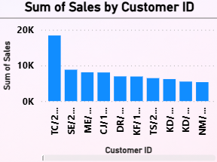
Top Customer Analysis
Content:
Top 10 customers contribute ~40% of total sales.
High repeat purchase rate among premium clients.
Smaller customers show inconsistent buying patterns.
Insight: “Strengthen loyalty programs for top clients; target retention campaigns for mid‑tier customers.”

Slide 7
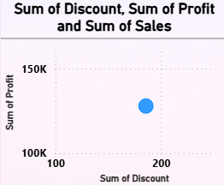
Discount vs Profit Relationship
Content:
The chart compares discount levels (x‑axis) with profit outcomes (y‑axis).
A data point around 200 discount → 150K profit suggests that even with higher discounts, profit can still be strong in certain cases.
However, discounts generally reduce margins, so the relationship must be carefully managed.
Sales volume (third measure) is also influenced by discounting, but excessive discounts risk eroding profitability.
Insight: “Discounts can boost sales but may compress margins. Optimal discounting strategy is needed to balance revenue growth with profitability.”

Slide 8
Summary & Next Steps
Detailed Summary:
Overall Performance: Sales have reached 507.79K and Profit 127.87K, showing consistent growth. However, the Profit Margin (0.25%) is very low, highlighting cost inefficiencies and heavy discounting.
Trends: Both Sales and Profit grew steadily, with Q4 spikes each year due to holiday demand. This seasonal pattern is predictable and requires proactive planning.
Category Insights: Copiers and Machines are the most profitable categories, while Furniture and Bookcases underperform. Technology‑related categories are driving margins, suggesting where investment should focus.
Regional Insights: The West region dominates in both Sales and Profit, while the South region lags behind. This imbalance shows untapped potential in weaker regions.
Customer Insights: The Top 10 customers contribute ~40% of sales, showing strong loyalty but also dependency on a small group. Smaller customers are inconsistent, which is a risk for long‑term stability.
Next Steps (Action Plan):
Optimize discounting and pricing strategies to protect margins.
Expand high‑margin categories (Technology, Office Supplies).
Launch targeted campaigns to boost South region performance.
Strengthen loyalty programs and retention strategies for top clients.
Diversify customer base to reduce dependency on a few accounts.
Insight: “By addressing margin efficiency, regional gaps, and customer concentration, the Super Store can achieve sustainable growth and long‑term profitability.”

